Slide 1
“Behind The Scenes” A Video Edit Reveal
Video1: Couch Magic (How to take away the couch from your twin)
Video2: Goodnight Switch
Video3: Congratulations Manny #PacquiaoBroner

Slide 5
Video Edit Reveal

Slide 6

MASKING
Image 1:
The human face (Eyes, ears, nose etc)
Image 2:
The string “TEXT”

Slide 7
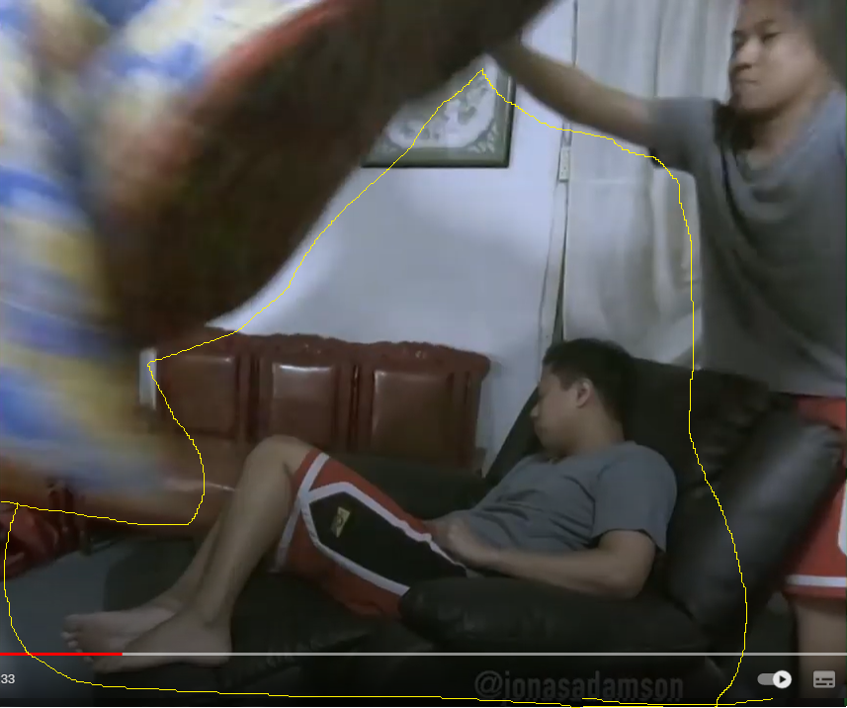
VIDEO 2
VIDEO 1

Slide 8
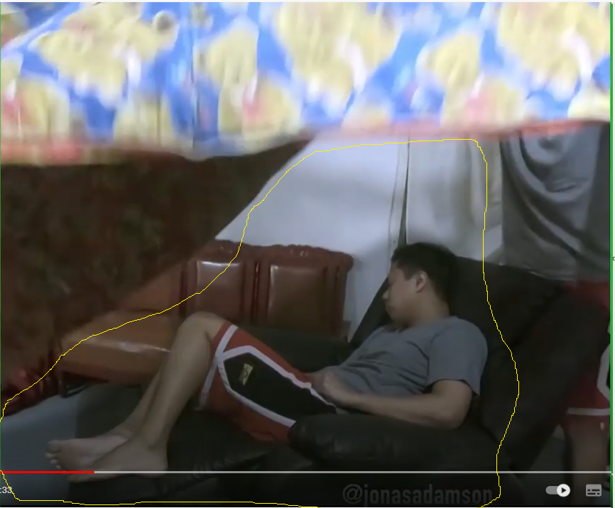
VIDEO 2
VIDEO 1

Slide 9
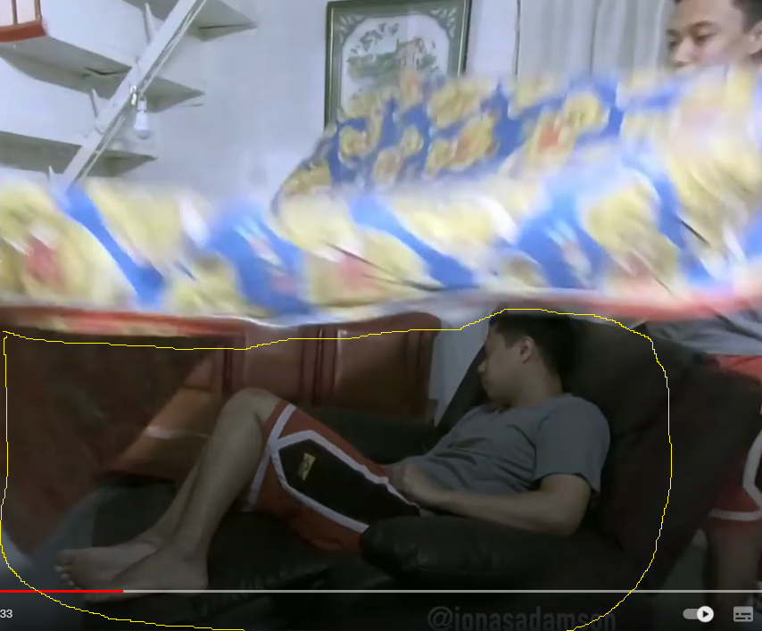
VIDEO 2
VIDEO 1

Slide 10
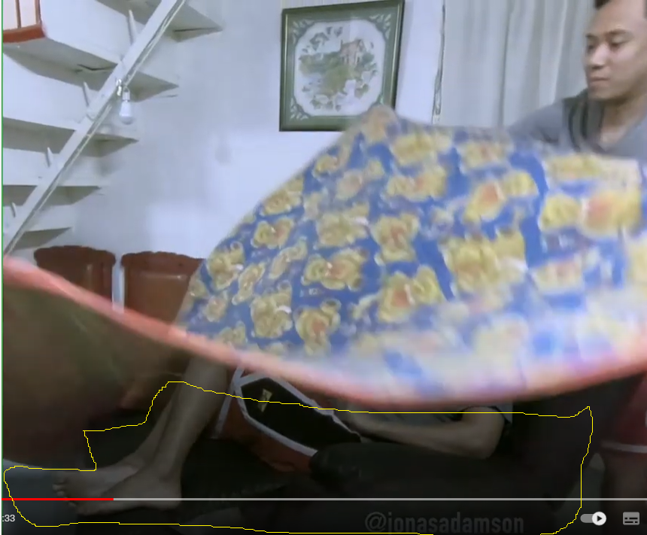
VIDEO 2
VIDEO 1

Slide 11
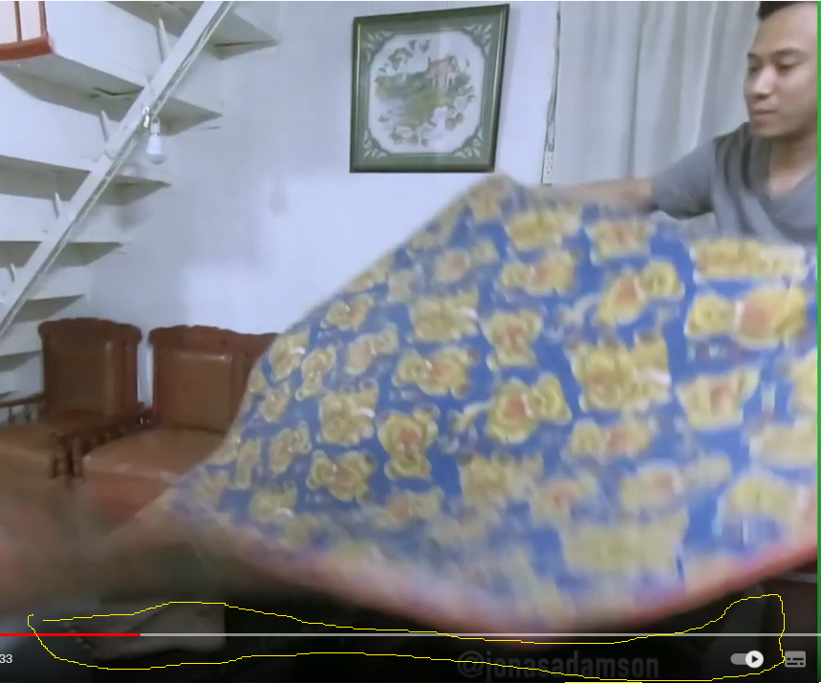
VIDEO 2
VIDEO 1

Slide 14
TIPS
Use a tripod
Framing
Color grading

Slide 15
SHARING
MOST DIFFICULT
ENJOYABLE
DISLIKE
Notes:
Conceptualization,
Putting the sound effects and looking at the finished product
Frame by frame editing

